Slide 1



Replacing Hollywood with Nollywood
John Ugbe
April, 2017

Slide 2

Agenda
Overview
Cultural Awakening
What Changed?
Fixing Distribution
Our Movies found Wider Appeal
Plenty of Work to be Done
What the Future looks like

Slide 3

Overview
Nigeria’s interest in cinema traced back to the colonial era
Herbert Macaulay, father of Nigerian nationalism invited the Balboa and Company to show silent films in 1903.
These were shown at the Glover Memorial Hall, Lagos in August of the same year
Interest in cinema quickly took root, but it was expensive. Film stocks were expensive to import and celluloid expensive to process.
We developed a culture of going to the cinemas to watch Indian movies of love and deception, and Chinese movies about martial arts
* Source: http://filminnaija.blogspot.com.ng/2007/05/history-and-development-of-nigerian.html

Slide 4


Cultural Awakening
Storytelling, a part of our tradition…
Our forefathers’; Hubert Ogunde (and his peers), the fathers of Nigerian theatre
Folktales under the tree
A marriage of film and tradition; Tales by Moonlight

Slide 5


What Changed?
In the 1980s, the cassette culture grew; Betamax, VHS, then…
The home video happened -
(Living in Bondage)
The entry barrier lowered
Camcorders became more affordable
Commercialization
The growth of social media
The power of smart phones; ability to shoot skits and upload – Kraks TV, Pulse TV etc
Corporate storytelling – the banks
…the rise and rise of USER GENERATED CONTENT

Slide 6






Fixing Distribution
BoxOffice creates an extra level of income for filmmakers
On BoxOffice, October 1 out-performed Hollywood movies between December 2014 & January 2015
It recorded more rentals than Hercules with Dwayne Johnson and Lucy with Scarlett Johansson!
Imagine filling all our cinemas at the same time, 5x their regular capacity
More recently, 76 – enjoyed similar patronage on BoxOffice
It’s a form that has come to be accepted, it’s about supply meeting demand
Pay TV
In 2006, Irapada, a Kunle Afolayan movie grossed N5 Million in the cinemas – that’s about 3,000 rentals altogether.
In 2013, Half of a Yellow Sun grossed N60 Million about 40,000 rentals, while in 2016, The Wedding Party grossed N450 Million about 300,000 rentals
Source: https://en.wikipedia.org/wiki/List_of_highest-grossing_Nigerian_films)
…then FTA

Slide 7

Our Movies found Wider Appeal
In spite of modernization, we retained our love for the same recurring themes; love, betrayal, the interfering mother-in-law, juju! We began to tell our own stories in our indigenous languages.
Diaspora consumption
With about 20 million Nigerians in the Diaspora, there’s a wider market ready to consume Nigerian stories
Improved quality
Nollywood week Film Festival in France
Transfer of norms, mannerisms
Oyinbo’ speaking pidgin, Chinese speaking pidgin in adverts
Use of Oga

Slide 8

Plenty of Work to be Done
A market needs to be developed, and this is what we are trying to do…
Deloitte puts MultiChoice Nigeria’s aggregate economic impact from 2011 to 2015 at $1.1billion.
Some of what has been achieved through this are;
Material partnerships and financial support
Training, master classes for up coming talent
Content acquisition, co-productions and commissioning of movie projects,
Increased Nigerian content on the Africa Magic channels
$1.1 billion
$387.6billion
$388M
$322M
$132M
-2013
2011-2015
2011/12
2013/14
2014/15
Aggregate economic impact
GDP Contribution
Notes:
Having the required infrastructure in place is half the job done
At MultiChoice, we knew we wanted our product to be accessible by a wide range of customers all over Nigeria. This gave birth to our distribution value chain: This involves developing a distribution chain with a number of dealership levels, which helped get our products to our customers more efficiently. This initiative is also an economic empowerment drive as it helped to create extra income at the various levels.
Studios & production facilities: We also realized that we would need production studios both for our coverage of sports and to develop AfricaMagic Original Films (AMOF) which we are passionate about. Programs such as Tinsel, Jara, Studio 53, Monday Night Football, Naija Made are all produced at our state of the art studios in Ilupeju.
OB Vans cost millions to buy and maintain. They enable us broadcast events remotely. They are a vital tool in our ability to showcase events happening outside our studios.

Slide 9
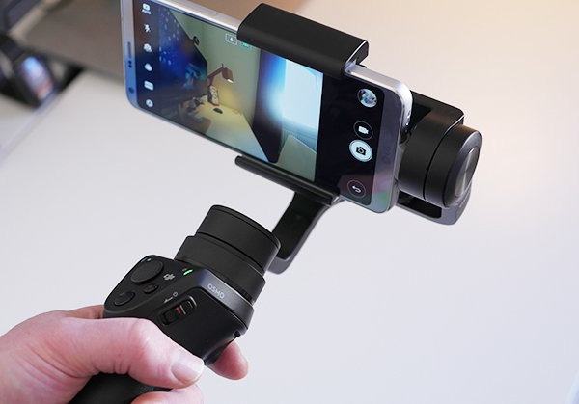



What the Future looks like
The entry barrier has lowered even further;
The SMART PHONE
has become the camcorder
VIDEO UPLOADS
on the rise and people are making money from them. These range from exercise classes to online educational videos
With the DIGITAL MIGRATION there will come a hunger for more home-grown content (FTAs)
Notes:
Incentive to innovate
Exclusivity provides a guarantee that sufficient returns will be earned on the investments undertaken on creative works. Without some form of guaranteed return on investment, entertainment practitioners will have reduced incentives to make investments i.e actors, film makers, and musicians.
Drives competition
Exclusivity also forces other entertainment practitioners who are not party to those arrangements to invest in and possibly enter into their own exclusive arrangements that involve the development and provision of new content. This in turn leads to improvements in the quality and variety of content and choice available to consumers. It is important to note that a highly competitive broadcasting industry engenders pluralism and diversity

Slide 10





Summary
Opportunity to attract international partnerships
- Feature alongside Hollywood actors = creative equality
More people willing to tell original stories
Quest for continuous improvement
AMVCA, other film festivals
Notes:
Incentive to innovate
Exclusivity provides a guarantee that sufficient returns will be earned on the investments undertaken on creative works. Without some form of guaranteed return on investment, entertainment practitioners will have reduced incentives to make investments i.e actors, film makers, and musicians.
Drives competition
Exclusivity also forces other entertainment practitioners who are not party to those arrangements to invest in and possibly enter into their own exclusive arrangements that involve the development and provision of new content. This in turn leads to improvements in the quality and variety of content and choice available to consumers. It is important to note that a highly competitive broadcasting industry engenders pluralism and diversity

Slide 11
Ends
Notes:
Incentive to innovate
Exclusivity provides a guarantee that sufficient returns will be earned on the investments undertaken on creative works. Without some form of guaranteed return on investment, entertainment practitioners will have reduced incentives to make investments i.e actors, film makers, and musicians.
Drives competition
Exclusivity also forces other entertainment practitioners who are not party to those arrangements to invest in and possibly enter into their own exclusive arrangements that involve the development and provision of new content. This in turn leads to improvements in the quality and variety of content and choice available to consumers. It is important to note that a highly competitive broadcasting industry engenders pluralism and diversity

